Slide 1
Artificial Intelligence:
Hamza Nadeem
Monica Restrepo
Nency Borad
Ajinkya Mukherjee

Slide 2
Project Part I: Exploratory Data Analysis

Slide 3
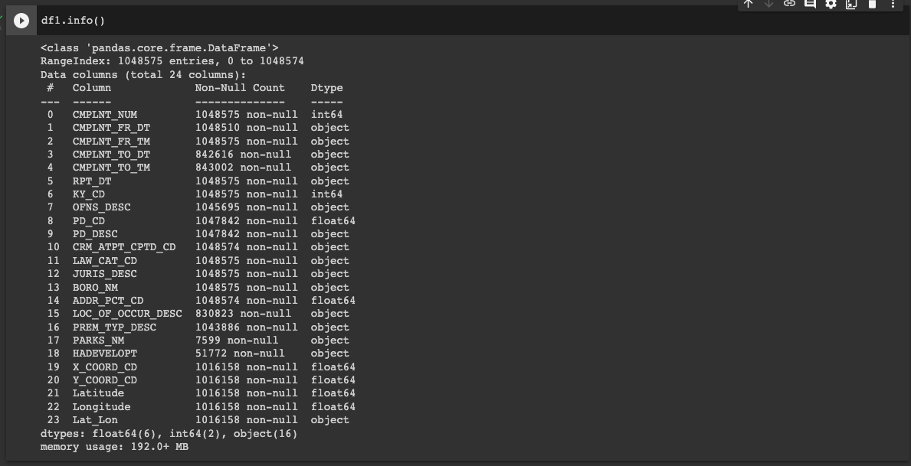
info()
Command Used: df1.info()
Notes:
10s

Slide 4
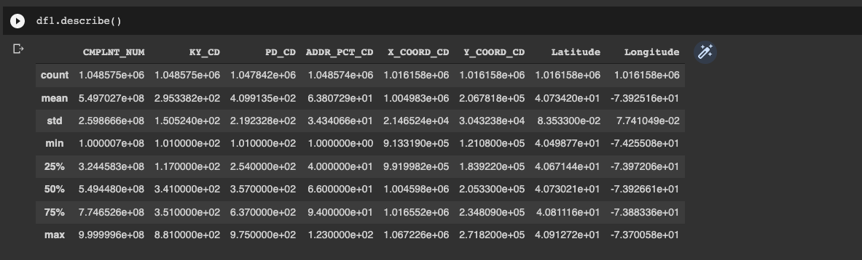
describe()
Command Used: df1.describe()
Notes:
We next use the describe function to help us determine the count, mean, standard deviation and other statistical information about each column.
10s

Slide 5
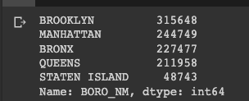

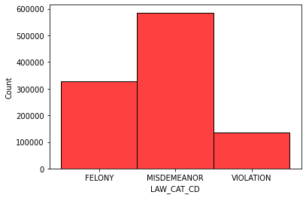
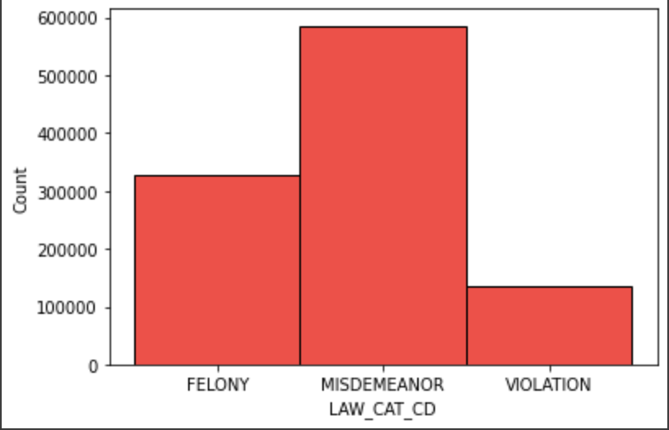
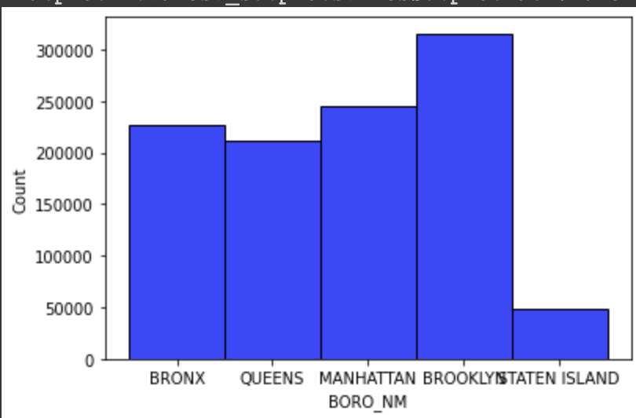
unique()
Command Used: counts = df1['LAW_CAT_CD'].value_counts() &
burr = df1['BORO_NM'].value_counts()
Notes:
After doing our preliminary research we were intrigued by two columns, LAW_CAT_CD and BORO_NM
As we can see we were able to get the total number of Values from each category under the two columns.
This helped us determine the type of crime and the burrows where the crimes were reported.
10s

Slide 6
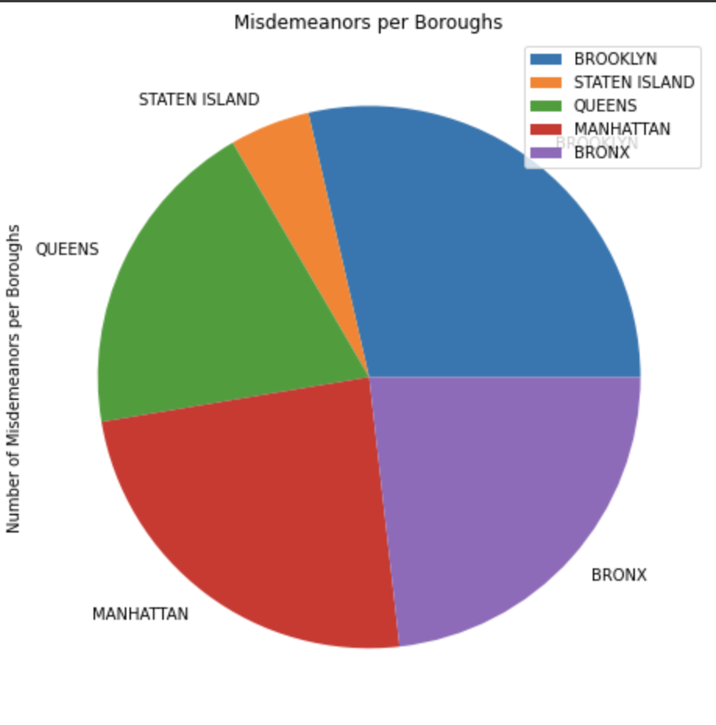
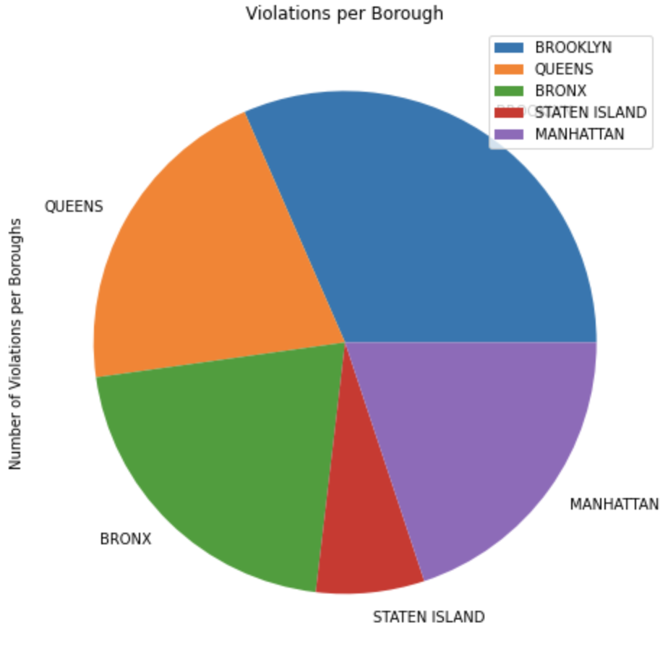
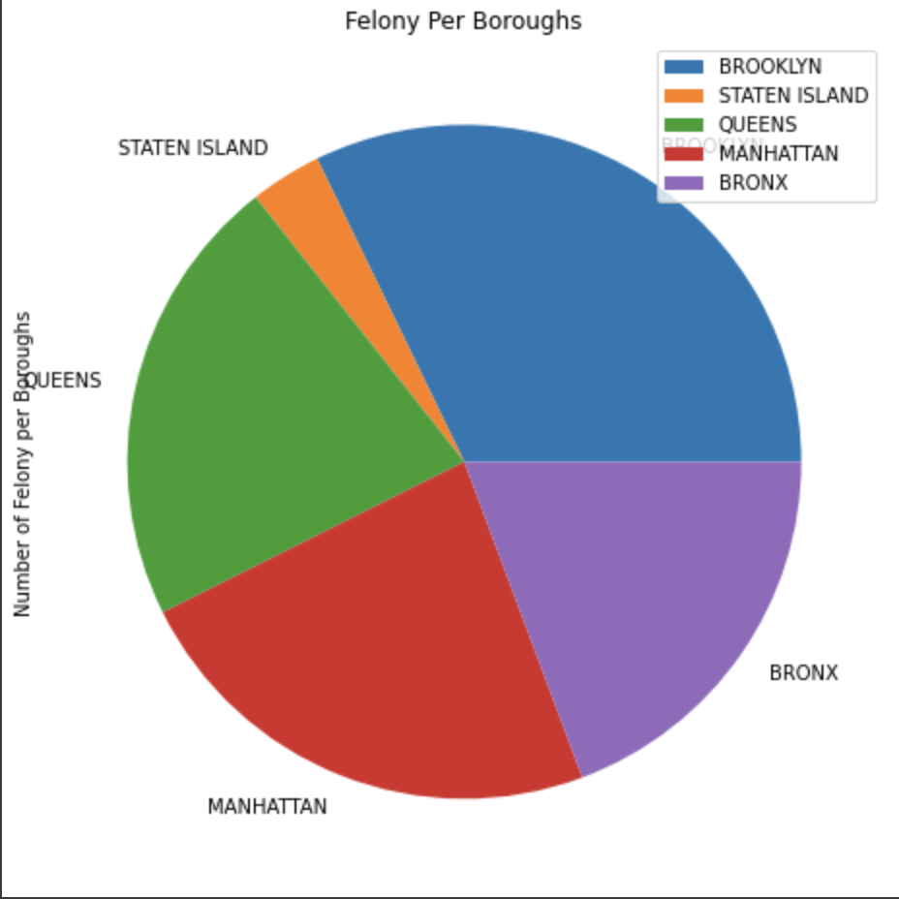
Crime Per Burrow
MISDEMEANORS VIOLATIONS FELONY
Notes:
10s

Slide 7
Project Part II: Prediction Modeling

Slide 8
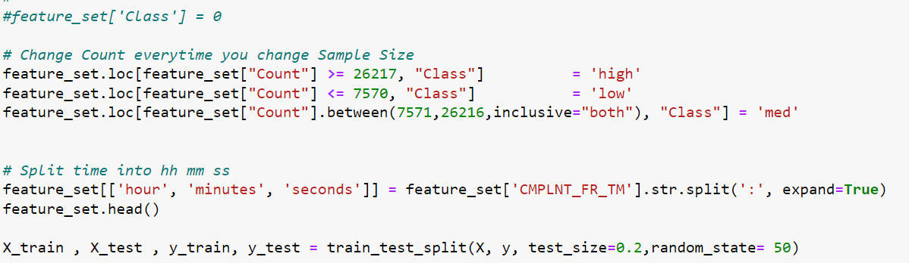
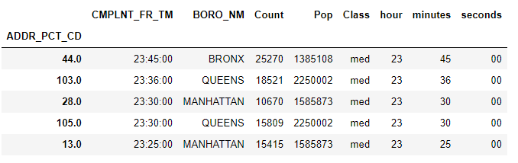
Features & Class
Features(X)
Complaint Number
Population
Time
Crimes Per Area
Class(y)
Low: <= 7570
Medium: 7571 - 26216
High: 26217

Slide 9
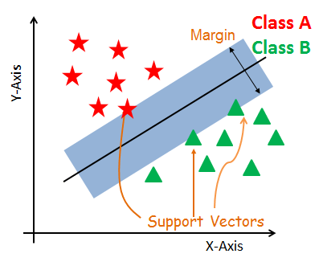
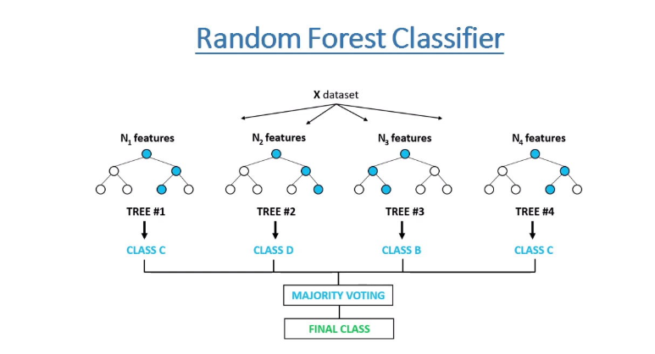
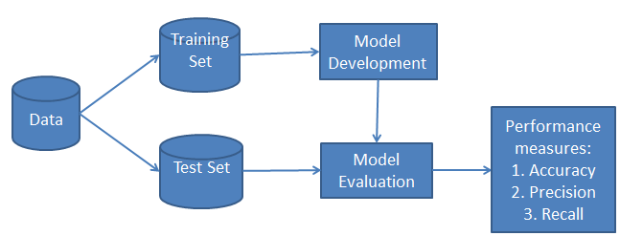
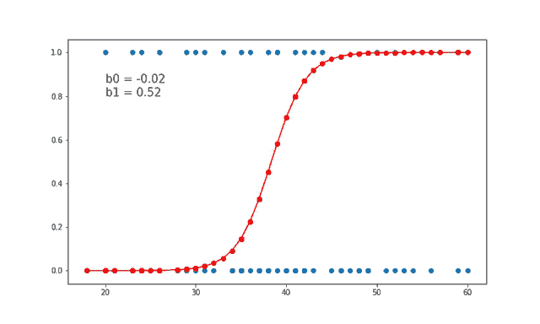
Algorithms used
1) SVM
2) Bayes (NB)
3) Random Forest
4) Logistic Regression (0 or 1)
1
2
3
4
Notes:
30s

Slide 10
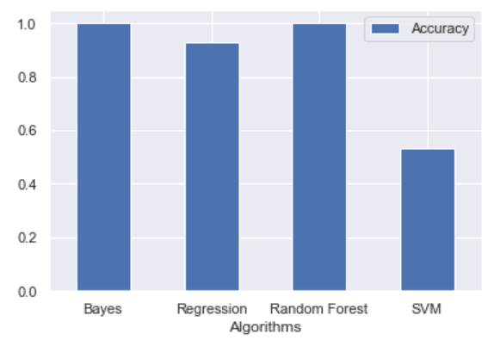
Algorithms used
Times calculated with TPU Processor
Algorithms | Time to Train | Accuracy
Naive Bayes | 1.4705965518951416s | 99.93%
Logical Regression | 3.7828752994537354s | 92.59%
Random Forest | 0.6684994697570801s | 100%
SVM | 35 Minutes 16s | 53.13%
Notes:
Ajinkya
2min

Slide 11
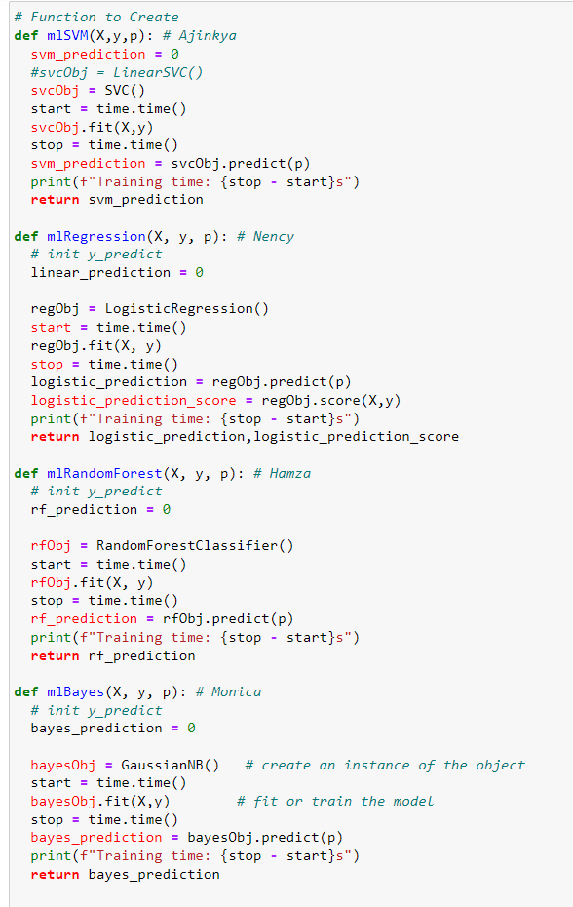
Algorithms used: Code Snippet
Notes:
Monica
2 min

Slide 12
Libraries Used
SciKit-Learn
svm.SVC
linear_model.LogisticRegression
ensemble.RandomForestClassifier
model_selection.train_test_split
metrics.accuracy_score
time
Notes:
30s

Slide 13
Future Considerations
Narrow the current Project down to Zipcodes ( We could not do it due to slow run time of the algorithms)
Add Perimeter Description to Feature set for better results
Notes:
30s

Slide 14
References:
https://scikit-learn.org/stable/modules/svm.html#svm
https://scikit-learn.org/stable/modules/generated/sklearn.ensemble.RandomForestClassifier.html?highlight=random%20forest#sklearn.ensemble.RandomForestClassifier
https://scikit-learn.org/stable/modules/classes.html?highlight=bayes#module-sklearn.naive_bayes
https://scikit-learn.org/stable/modules/generated/sklearn.linear_model.LogisticRegression.html?highlight=logisticregression#sklearn.linear_model.LogisticRegression

Slide 15
THANK YOU

